Slide 1

HETEROPLASMY IN HUMAN MITOCHONDRIAL GENOME MUTATION RATES DIFFERENCES.
Keaton Banik

Slide 2
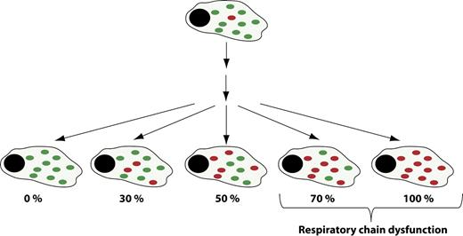
Mitochondria Background
Make ATP
Immunity
Apoptosis
Cell Signaling
SEPARATE GENOME
Many Copies (NOT 2n)
Park C B , and Larsson N J Cell Biol 2011

Slide 3
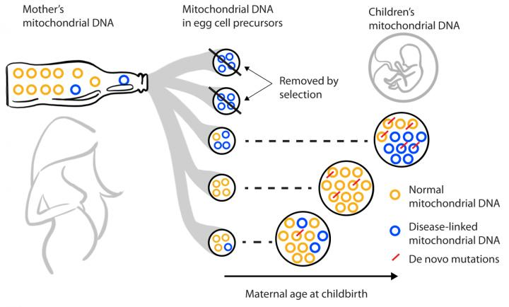
Heteroplasmy
Mix of many variants of mtDNA
Mutant and wildtype mtDNA exist in cells
Seen in mtDNA disease (% = severity)
Asymptomatic Mother can pass on variant to children
https://www.zmescience.com/other/science-abc/about-mitochondrial-dna-42423/
https://phys.org/news/2019-11-tracking-inheritance-human-mitochondrial-dna.html

Slide 4
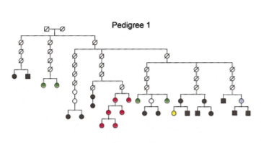
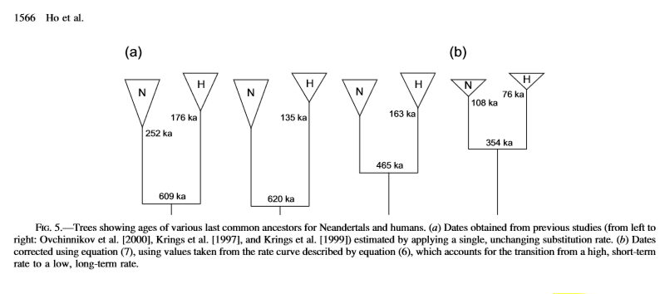
Evolution Rate Estimate Methods
Pedigree
Phylogeny
Sigurğardóttir, S., Helgason, A., Gulcher, J. R., Stefansson, K., & Donnelly, P. (2000). The mutation rate in the human mtDNA control region. American journal of human genetics, 66(5), 1599–1609.
Ho, S. Y., Phillips, M. J., Cooper, A., & Drummond, A. J. (2005). Time dependency of molecular rate estimates and systematic overestimation of recent divergence times. Molecular biology and evolution, 22(7), 1561–1568.

Slide 5


Controversy
Phylogenetic:
Mitochondria DNA differential mutation and substitution rates
Phylogenetic
Low Substitution Rate
Long Timescale (high sequence time difference)
Pedigree
High Mutation Rate
Short Timescale (short sequence time difference)
Pedigree:
Sigurğardóttir, S., Helgason, A., Gulcher, J. R., Stefansson, K., & Donnelly, P. (2000). The mutation rate in the human mtDNA control region. American journal of human genetics, 66(5), 1599–1609.

Slide 6
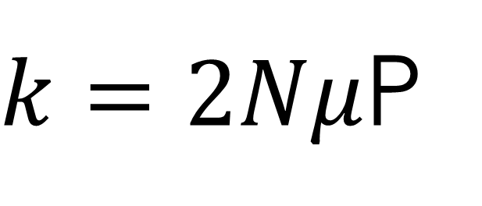
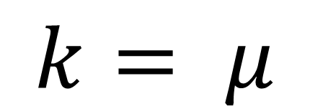
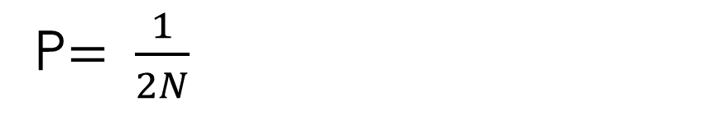
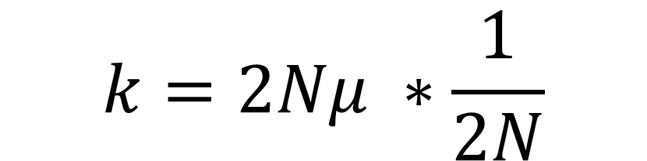
Molecular Clock
Mutations/gen/site
$k=2Nμ$P
Rate of Substitution/Gen
Rate of Mutation
Probability of Fixation of Neutral Allele
Kimura’s Neutral Evolution
Population Size
Kimura, M. (1983). The neutral theory of molecular evolution. Cambridge University Press.
P$= \frac{1}{2N}$
$$k=2Nμ ∗\frac{1}{2N}$$
$$k= μ$$

Slide 7

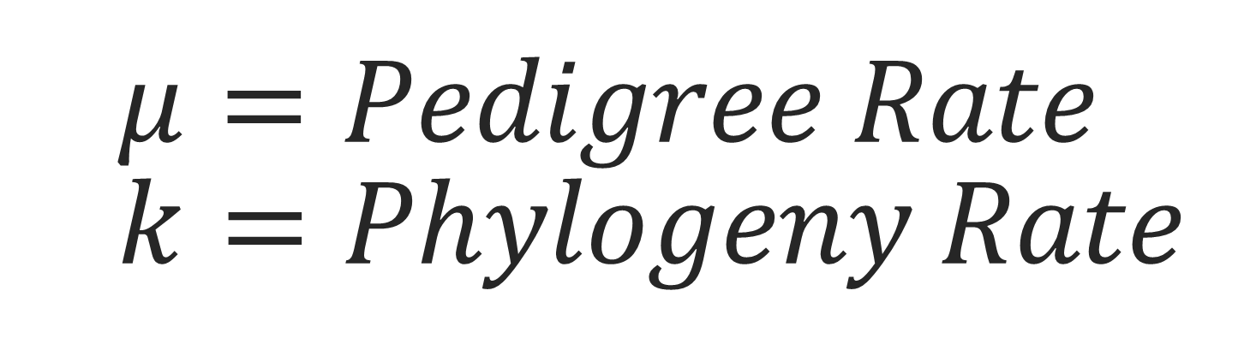
$$μ=Pedigree Rate \\ k=Phylogeny Rate$$
$$μ=k$$

Slide 8
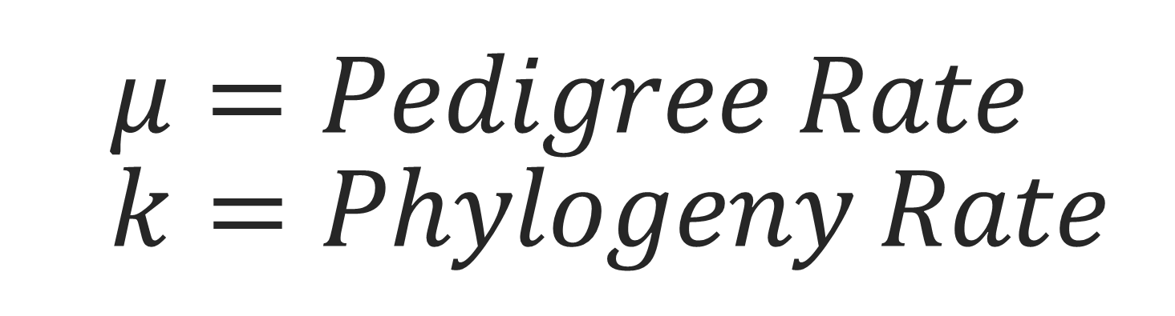

$$μ=Pedigree Rate \\ k=Phylogeny Rate$$
?? $μ≠k$??

Slide 9
Previous work
Many proposed hypotheses:
Negative Selection
“Two-Hit” Hypothesis
mtDNA “Hotspots” account for multiple mutations in single region
Detected only in pedigree
Only works in certain studies (Human-Chimp)_{[1]}
Timescales of Evolution
Calibrating using Archeological evidence for sequence divergent event times_{[2]}
Scale “Evolution rate” to time “distance” away from present.
Sequencing/Database Errors
Vastly different sequences within families (< 2%)
Low variance →LARGE impact of Sequence errors
[1] Henn, B. M., Gignoux, C. R., Feldman, M. W., & Mountain, J. L. (2009). Characterizing the time dependency of human mitochondrial DNA mutation rate estimates. Molecular biology and evolution, 26(1), 217–230 .
[2] Ho, S. Y., Phillips, M. J., Cooper, A., & Drummond, A. J. (2005). Time dependency of molecular rate estimates and systematic overestimation of recent divergence times. Molecular biology and evolution, 22(7), 1561–1568.

Slide 10
HETEROPLASMY
The Key?

Slide 11
Aims & Objectives
OBJECTIVE
Evaluate potential reasons for the discrepancy in evolution rates estimates in Mitochondrial DNA.
AIMS
Mutation Rate Estimates between Mother Child mtDNA pair Data
Observe Rate Estimate changes in response to Heteroplasmy in Mother and Child
Observe Mutation Gradient in curated Dataset.
Implications on rate estimates

Slide 12
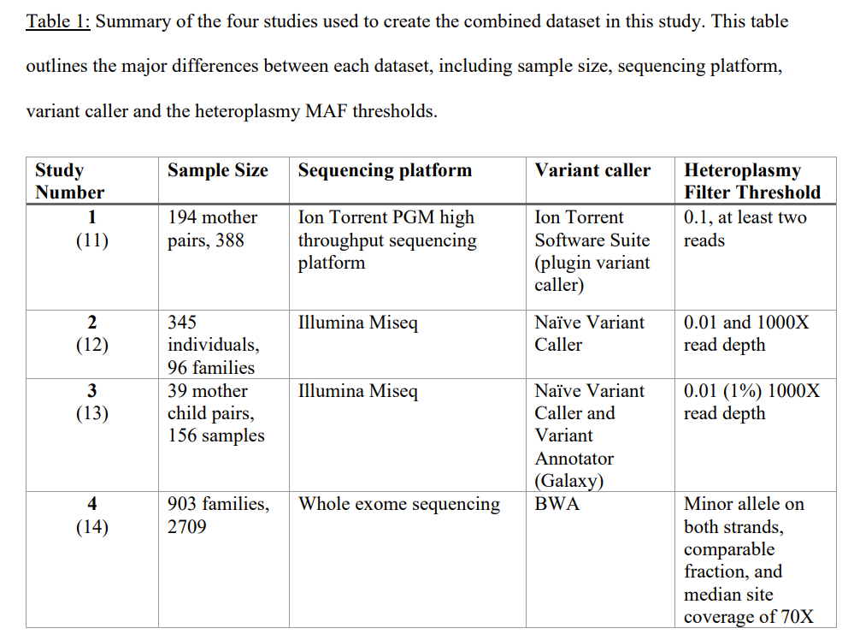
Methodology
Data Curation:
4 studies
3598 individuals sampled
Different Sequencing Platforms
Ion Torrent
MiSeq
Sanger Sequencing
Whole Exome Sequencing
Variant Callers
Ion Torrent Software Suite
Naïve Variant Caller + Variant Annotator (Galaxy)
Cambridge Reference Sequence (rCRS) by using “samtool mpileup”

Slide 13
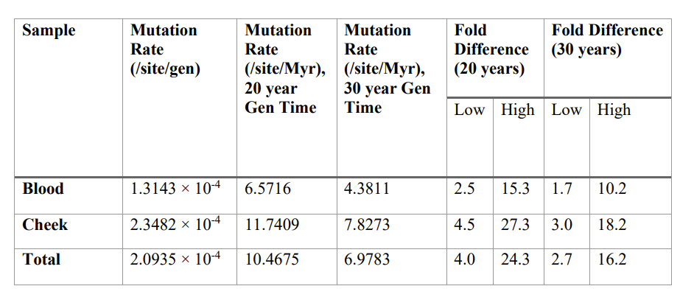
Results: Rate Estimates
>>> Literature Estimates

Slide 14
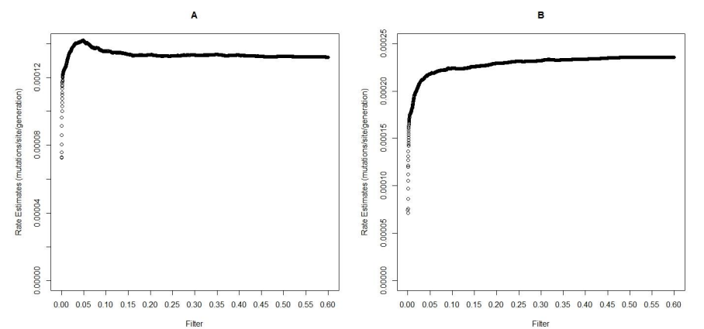
Results: Minor Allele Frequency (MAF)
> bloodMutRate
[1] 0.0001331827
> cheekMutRate
[1] 0.0002348187

Slide 15
Error in Estimates?
Heteroplasmy!
Literature Estimate: 5x10^{^-5}
Literature Estimate: 5x10^{^-5}

Slide 16
Error in Estimates?
Heteroplasmy!
Literature Estimate: 5x10^{^-5}
Literature Estimate: 5x10^{^-5}

Slide 17
Results
Mother Minor Allele Filtering
Mother MAF filtered rate estimates were similar to Child MAF filtered rate estimated
Much of the heteroplasmy in our dataset were between 0.0-0.05 MAF
Spatial Variation in the Mitochondrial Genome
Two observable peaks in variant frequency at two well studied hyper variable regions in all sample tissues
One peak only seen in cheek tissue that was unaccounted for

Slide 18
Conclusions
In mitochondrial based pedigree studies, inferences of de novo mutation vs inherited variation are unclear.
Heteroplasmy needs to be considered in rate analyses
No mention in timescale rate estimate studies
Revealed observable rate estimate differences with heteroplasmic samples
Spatial Mutational Gradient may factor into previous estimates
Unaddressed in previous studies
New HVR region (11 000 nucleotide, dehydrogenase subunit coding region)
Consideration of spatial variant in these studies.

Slide 19
Future Directions
Statistical Power
Sample specific rate statistical significance (blood vs cheek)
Histogram statistical significance (T and KS Tests)
Polymorphism Consideration
Apply a Poisson random field approximation from Mugal et al. to “evolution rate” used in timescale approximations
Account for polymorphism conflation of pedigree-based rate estimates
Explicit Mechanistic Simulations
To understand detection of de novo variants vs inherited variation.
Needs more input data (size of transmission bottleneck, accumulated somatic variation during development and cell division, germline variation, etc.)
Mugal, C. F., Wolf, J. B., & Kaj, I. (2014). Why time matters: codon evolution and the temporal dynamics of dN/dS. Molecular biology and evolution, 31(1), 212–231. https://doi.org/10.1093/molbev/mst192

Slide 20
Acknowledgements
Dr Jason De Koning & Lab
Dr David Anderson
Alberta Innovates

Slide 21
Thank you
Questions?

Slide 22
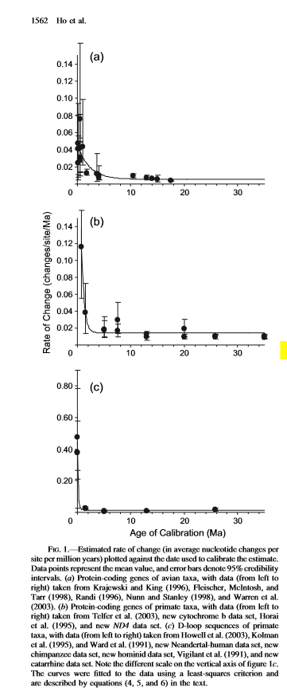
Time Scales?
Use Paleontological or biogeographical data to “calibrate” rate
Uses Bayesian analysis estimation with a “relaxed molecular clock model”
Found vertical translated exponential relationship between substitution and mutation rate.
Ho, S. Y., Phillips, M. J., Cooper, A., & Drummond, A. J. (2005). Time dependency of molecular rate estimates and systematic overestimation of recent divergence times. Molecular biology and evolution, 22(7), 1561–1568.

Slide 23
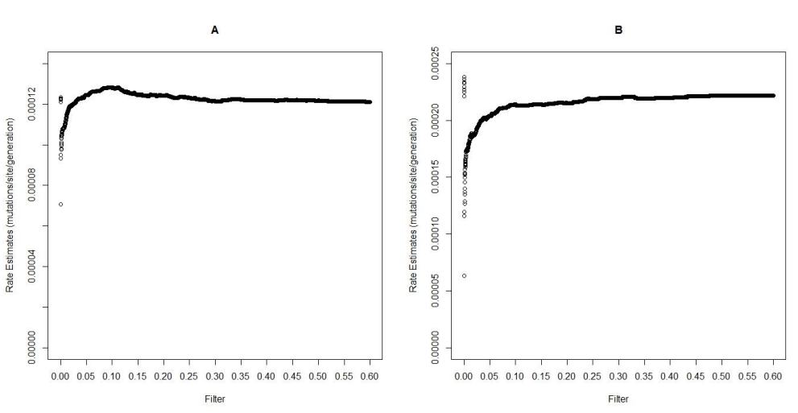
Results Mom MAF
Literature Estimate: 5x10^{^-5}
Literature Estimate: 5x10^{^-5}

Slide 24
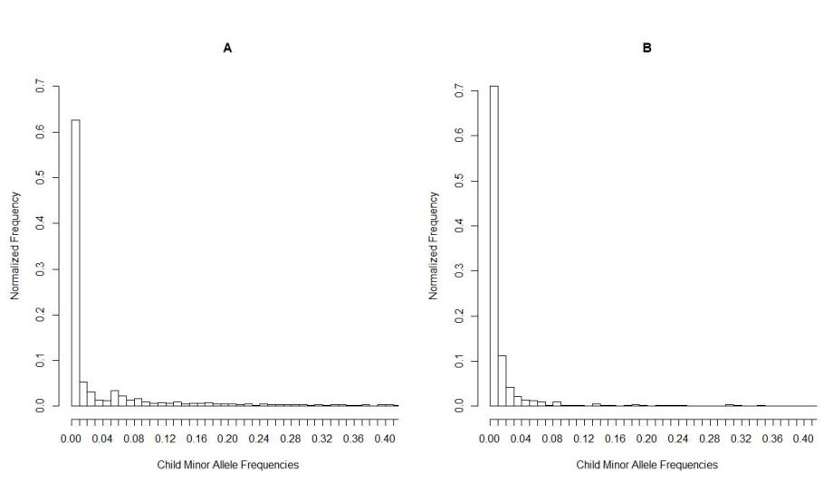
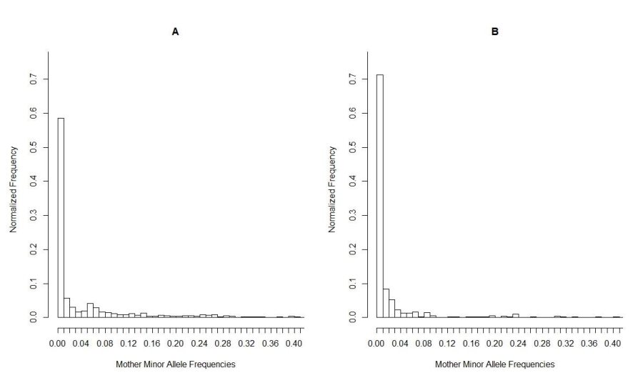
Variant Distribution

Slide 25
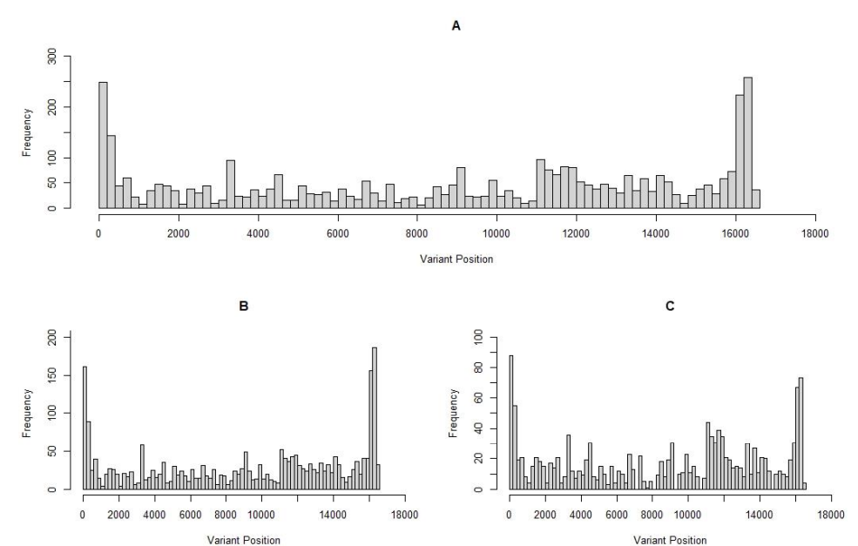
“Hotspots”
Regions of Higher mutation rate.
Hyper Variable Region (HVR) 1 (~16000) has higher average mutation rate/myr _{[1]}
H and L strand Origin of Replication at ~600 (D-Loop HVR) _{[2]}
[1] Henn, B. M., Gignoux, C. R., Feldman, M. W., & Mountain, J. L. (2009). Characterizing the time dependency of human mitochondrial DNA mutation rate estimates. Molecular biology and evolution, 26(1), 217–230 .
[2]Taanman J. W. (1999). The mitochondrial genome: structure, transcription, translation and replication. Biochimica et biophysica acta, 1410(2), 103–123. https://doi-org.ezproxy.lib.ucalgary.ca/10.1016/s0005-2728(98)00161-3
Notes:
Dehydrogenzae at 12k

Slide 26
“Hotspots”
Regions of Higher mutation rate.
Hyper Variable Region (HVR) 1 (~16000) has higher average mutation rate/myr _{[1]}
H and L strand Origin of Replication at ~600 (D-Loop HVR) _{[2]}
[1] Henn, B. M., Gignoux, C. R., Feldman, M. W., & Mountain, J. L. (2009). Characterizing the time dependency of human mitochondrial DNA mutation rate estimates. Molecular biology and evolution, 26(1), 217–230 .
[2]Taanman J. W. (1999). The mitochondrial genome: structure, transcription, translation and replication. Biochimica et biophysica acta, 1410(2), 103–123. https://doi-org.ezproxy.lib.ucalgary.ca/10.1016/s0005-2728(98)00161-3
Notes:
Dehydrogenzae at 12k

